Slide 1


Revolutionizing Vehicle Registration: The Blockchain Solution
A blockchain solution for the registration of motor vehicles in RTO provides an immutable, transparent, and efficient process that mitigates challenges in the traditional vehicle registration system.
By - Anshdeep Rawat
Course – BTech. CSE
Section – G1
Roll no – 10

Slide 2

Introduction
Project Overview
Importance of Vehicle Registration System
I've created a blockchain-based system to revolutionize how motor vehicles are registered in RTO.
Streamlined registration systems help prevent vehicle theft and improve safety on the roads.
Introduction to Blockchain Technology
Blockchain technology allows for the creation of an immutable and transparent digital ledger.

Slide 3



Current Challenges in Vehicle Registration
Inefficiencies in Traditional System
Lack of Transparency and Security
Delays and Paperwork
Paperwork and administrative bureaucracy slow down the process of vehicle registration and often lead to delays.
The old system is slow, inefficient, and prone to human error.
The traditional vehicle registration system is often opaque, making it difficult to track the history of a vehicle.

Slide 4

Benefits of Using Blockchain for Vehicle Registration
1
Immutable and Transparent Ledger
Blockchain technology creates a tamper-proof, unalterable digital ledger that can be accessed and updated by multiple parties.
2
Increased Security and Fraud Prevention
Blockchain technology ensures that all transactions within the system are secure and transparent, reducing the risk of fraud and corruption.
3
Streamlined and Efficient Process
Blockchain ensures a streamlined and efficient process for vehicle registration, with minimal paperwork, faster processing times, and fewer errors.

Slide 5
Reducing Corruption and Enhancing Transparency
1
Immutable Records
By storing vehicle registration details on a secure blockchain, the system eliminates the possibility of tampering or altering data.
2
Transparent Audit Trail
The decentralized nature of blockchain enables real-time monitoring and traceability of transactions, reducing opportunities for corruption.
3
Public Verification
Anyone can verify the authenticity and accuracy of vehicle records by accessing the blockchain's public ledger, enhancing trust and accountability.

Slide 6
Streamlining Communication and Improving Efficiency
Automated Processes
Real-time Updates
With blockchain, all stakeholders have access to real-time information, eliminating delays and enabling seamless communication between agencies.
Smart contracts on the blockchain enable automated workflows, reducing manual paperwork and accelerating the vehicle registration process.
Unified Data Management
By standardizing data formats and protocols, blockchain facilitates interoperability among different government entities, ensuring efficient data exchange.

Slide 7
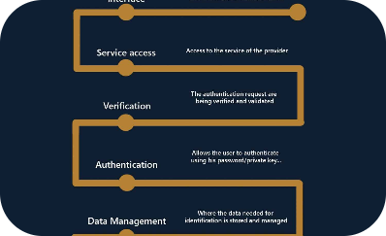
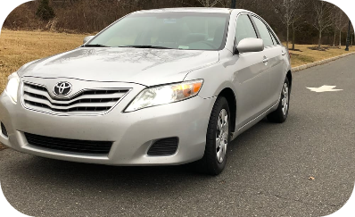
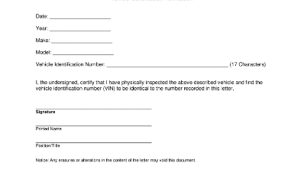
User Empowerment and Data Integrity
Self-sovereign Identity
Effortless Ownership Transfers
Traceable Vehicle History
Blockchain allows individuals to have control over their digital identities, enabling secure access to vehicle records and reducing data breaches.
Smart contracts on the blockchain facilitate seamless and secure transfer of vehicle ownership, eliminating the need for intermediaries.
Blockchain provides an immutable record of a vehicle's history, preventing odometer fraud and ensuring transparent insights for buyers.

Slide 8
Ensuring Enhanced Security and Reduced Fraud
1
Cryptographic Encryption
2
Smart Contract Auditing
Blockchain employs advanced encryption techniques, making vehicle registration details highly secure and resistant to unauthorized access.
Smart contracts on the blockchain allow for automated auditing, increasing accountability and reducing the likelihood of fraudulent activities.
3
Immutable Transaction History
Every registration and transaction recorded on the blockchain is permanent and cannot be altered, ensuring a reliable and tamper-proof system.

Slide 9
Efficiency in Record Keeping and Data Management
1
Eliminating Redundant Data Entry
Blockchain enables the sharing of standardized vehicle information, eliminating the need for redundant data entry across multiple systems.
2
Secure Data Storage
Vehicle registration details are securely stored and replicated across multiple nodes on the blockchain, ensuring high availability and data integrity.
3
Auditable Record Keeping
With blockchain, every change made to vehicle records is recorded, creating an auditable trail that can be referenced for compliance and accountability.

Slide 10
Unlocking the Power of Decentralization and Collaboration
Distributed Ledger Technology
Collaboration across Agencies
By employing a decentralized and distributed ledger, blockchain reduces the reliance on a centralized authority, enhancing transparency and fostering trust.
Blockchain enables multiple agencies, such as the RTO, insurance providers, and law enforcement, to collaborate and securely share vehicle data in real-time.
Efficient Dispute Resolution
Through smart contracts and immutable records, blockchain streamlines dispute resolution processes, reducing conflicts and enhancing customer satisfaction.

Slide 11


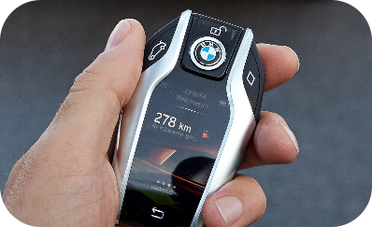
The Future of Vehicle Registration: Embracing Blockchain
Smart Cities Integration
Ongoing Technological Advancements
Revolutionizing Mobility Services
The integration of blockchain in vehicle registration paves the way for smart city initiatives, enabling seamless transportation management and optimization.
As blockchain technology evolves, new features and capabilities will enhance the security, scalability, and efficiency of vehicle registration systems.
Blockchain can empower individuals to share their vehicles securely, enable autonomous vehicle management, and unlock new mobility service models.

Slide 12
Implementation of Blockchain for RTO
Technical Requirements and Infrastructure
Integration with Existing Systems
The implementation of blockchain technology requires robust technical infrastructure and specific requirements to ensure smooth operations.
Integrating blockchain with existing systems poses unique challenges, a situation that requires a high level of expertise and collaboration.
User Experience and Accessibility
Ensuring that the user experience is simple and accessible for all users requires attention to detail and an intuitive user interface.

Slide 13

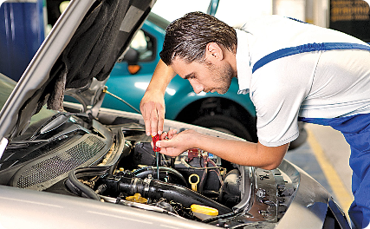
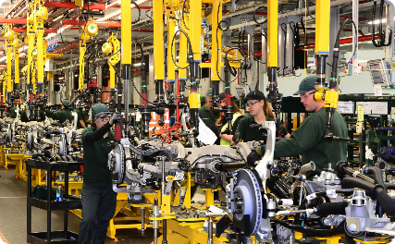
Future Possibilities and Potential Growth
Expansion to Other Regions and Countries
Integration with Other Services
Potential Impact on the Automotive Industry
The introduction of blockchain technology in RTO could have global potential and lead to expanded use cases in other regions and countries.
Blockchain integration could lead to complete vehicle life-cycle management, including maintenance, insurance, and resale.
The use of blockchain technology could disrupt the traditional automotive industry, leading to innovative new business models and opportunities.

Slide 14
Conclusion
1
Summary of the Benefits and Potential of Blockchain
2
Call to Action for Adoption and Collaboration
3
Q&A Session
Let's address your queries and discuss the potential of blockchain in revolutionizing vehicle registration.
It's time to adopt blockchain technology and collaborate together to drive innovation and positive change in the transportation industry.
Blockchain presents a unique opportunity to transform the vehicle registration system, reducing inefficiencies, increasing security, and promoting transparency.

